Slide 1


IoT Solution for Silk Production
Improvement of Silkworm Lifestyle and Quantity of Silk Production
Presented by
Md. Asmaul Hossain Murad (1703130)
Nadia Subrin (1703147)
A.J. Jasim Uddin (1703164)
Sabbir Hossain (1703173)
A.S.M. Shahria (1603067)

Slide 2
IoT Solution for Silk Production
Topics
Sericulture and Silk Production
Internet of Things(IoT)
Need of IoT in Sericulture
Application of IoT in Sericulture

Slide 3
IoT Solution for Silk Production
What Does Sericulture Mean?
Sericulture, or silk farming, is the cultivation of silkworms to produce raw silk.
The production of silk products depend on the quality and quantity of raw silk.
Ultimately, the more advanced technique, the more one will get raw silk.

Slide 4
IoT Solution for Silk Production
Process Followed in Sericulture:
Moriculture – The cultivation of mulberry leaves.
Silkworm rearing – Promoting the growth of the silkworm.
Silk reeling – The extraction of silk filaments from the silkworm cocoons.
We will mainly deal with the second process
Silkworm rearing.

Slide 5
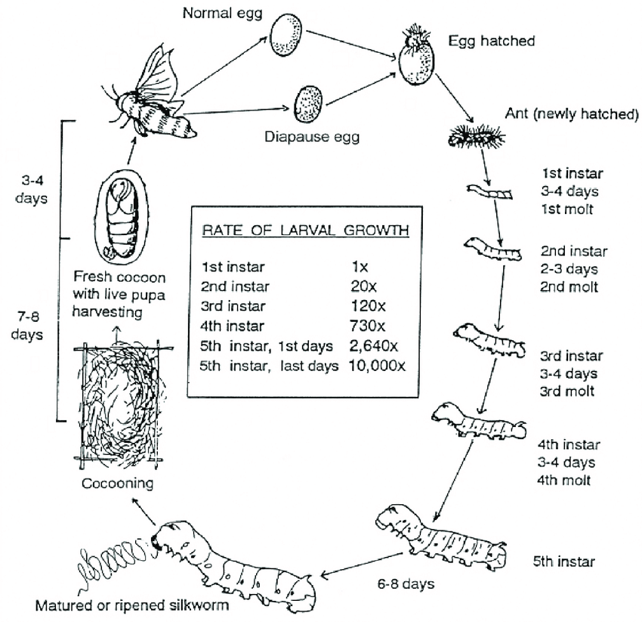
IoT Solution for Silk Production
A brief description of Silkworm Rearing
In sericulture, the silkworm rearing process begins with the laying of eggs by the female silk moth. Typically, 400-500 eggs are obtained from one female silk moth. These eggs (laid on a paper/cardboard sheet) are then disinfected with the help of a 2% formalin solution.
A feeding bed is prepared on a rearing tray by sprinkling chopped mulberry leaves onto it. The hatched larvae are transferred into this tray via a process known as brushing. In order to maintain humidity, foam strips are soaked in water and placed on the tray.
The silkworm larvae initially have a good appetite. As they grow, their appetite slowly diminishes until their active stage. At this stage, the silkworm eats enthusiastically until its final feeding stage.
After reaching maturity, the larvae begin searching for hospitable places to begin their pupation. At this stage, the body of the silkworm shrinks and becomes translucent. These mature larvae now wrap themselves in a cocoon by secreting saliva from the two salivary glands on their heads. This saliva solidifies and becomes silk when it comes in contact with air.

Slide 6
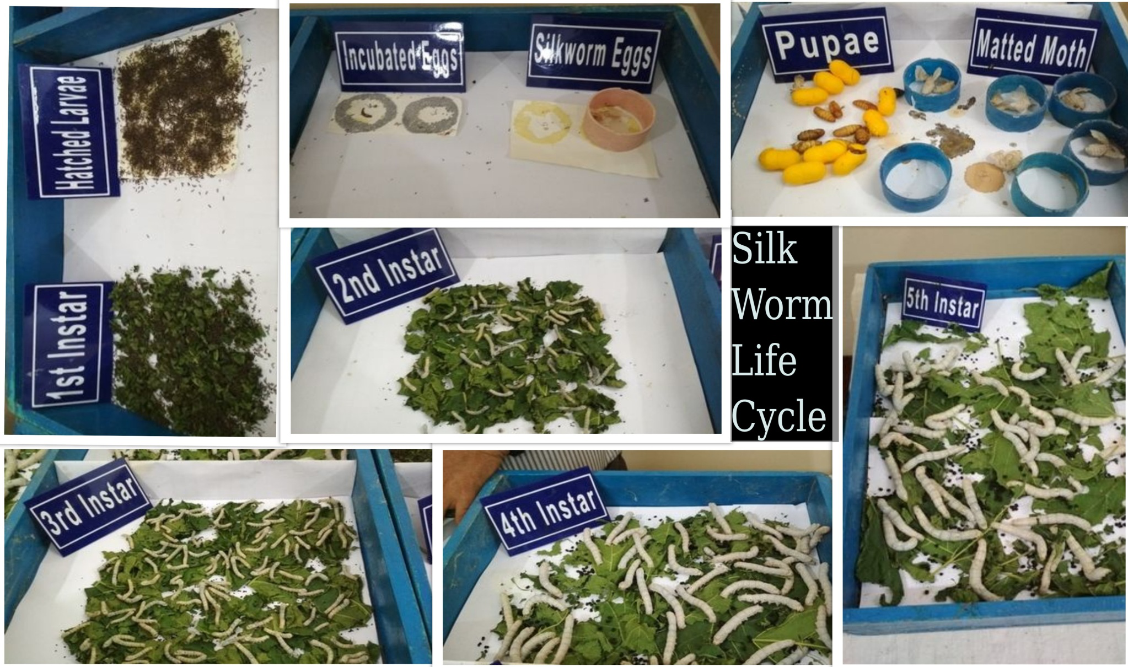
IoT Solution for Silk Production

Slide 7
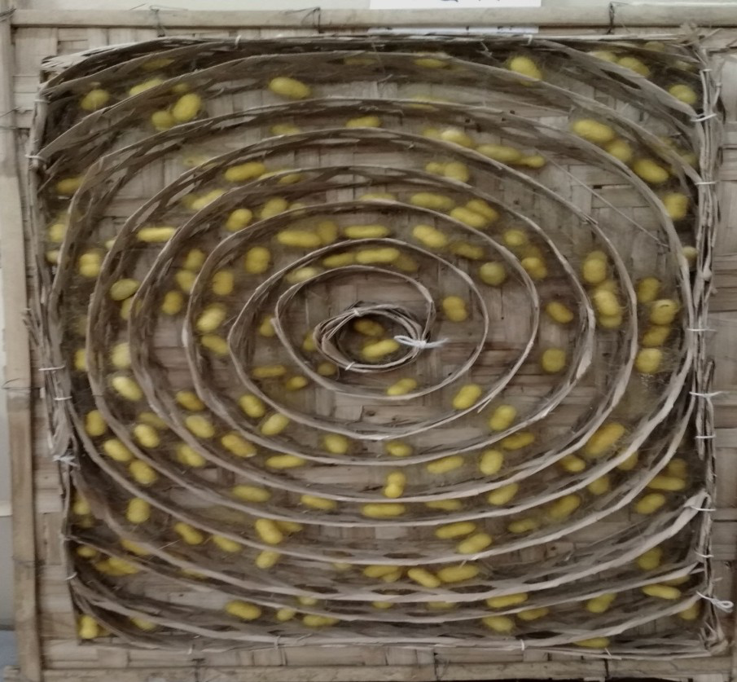
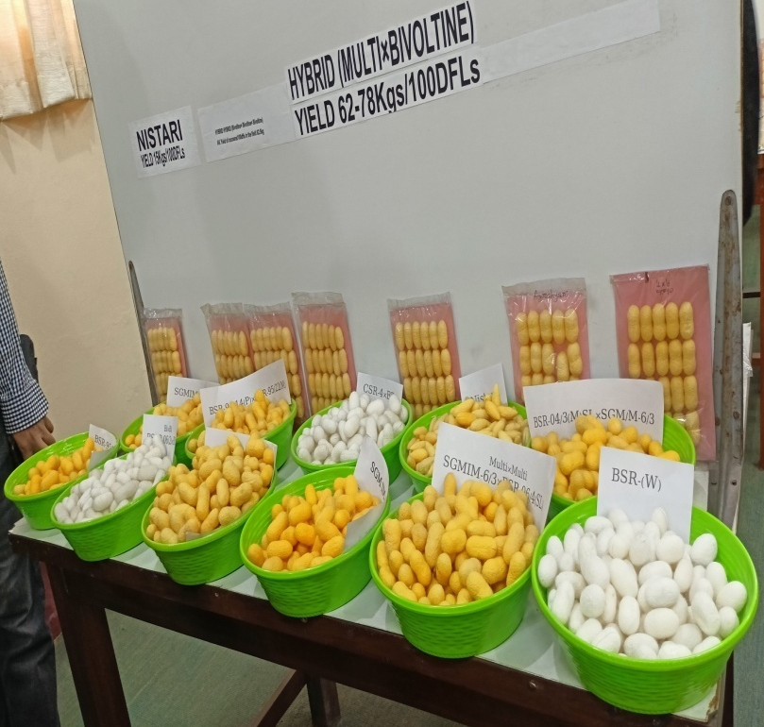
IoT Solution for Silk Production
A cocoon is a natural silk composite with a non-woven structure made of continuous silk fibers conglutinated by sericin bonding matrix.
Fig: Silk Cocoon

Slide 8
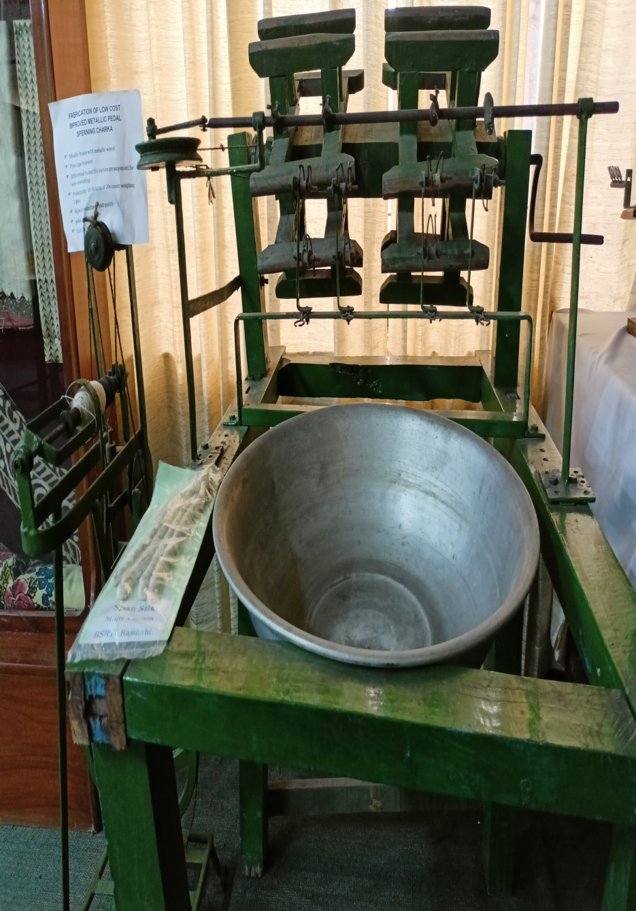
IoT Solution for Silk Production
Silk Reeling
Inside the cocoons, the larvae undergo metamorphosis and turn into pupae. The harvesting of silk from these cocoons is the final stage of sericulture. First, the pupae inside the cocoon are killed by boiling the cocoon and exposing it to steam and dry heat. This process is called stifling. Now, the silk filaments are removed from the dead cocoon via a process called reeling. When the cocoons are placed in boiling water for approximately 15 minutes, the adhesion of the silk threads reduces, enabling the separation of individual filaments. These filaments are twisted into a thread with the help of a series of guides and pulleys. This silk is then re-boiled in order to improve its luster. One thread of silk contains approximately 50 silk filaments. However, over 900 meters of filament can be obtained from a single cocoon. Thus, raw silk is obtained from the silkworm and the sericulture process is completed.
Fig: Machine for Processing Silk from Cocoon

Slide 9
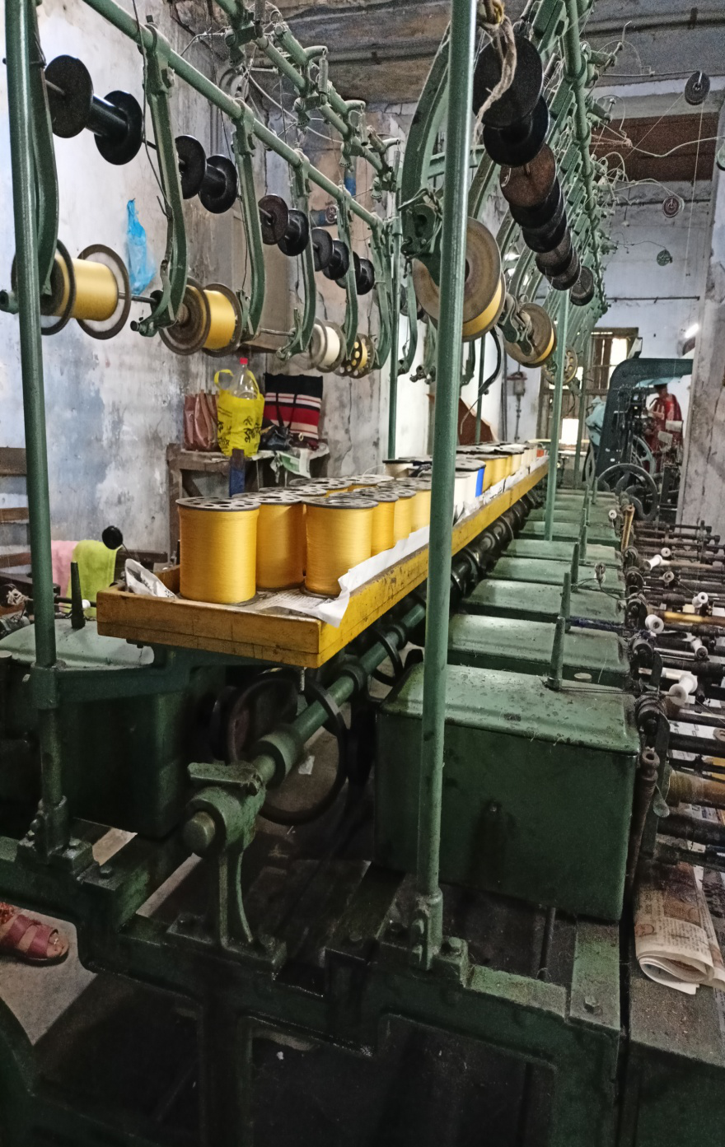
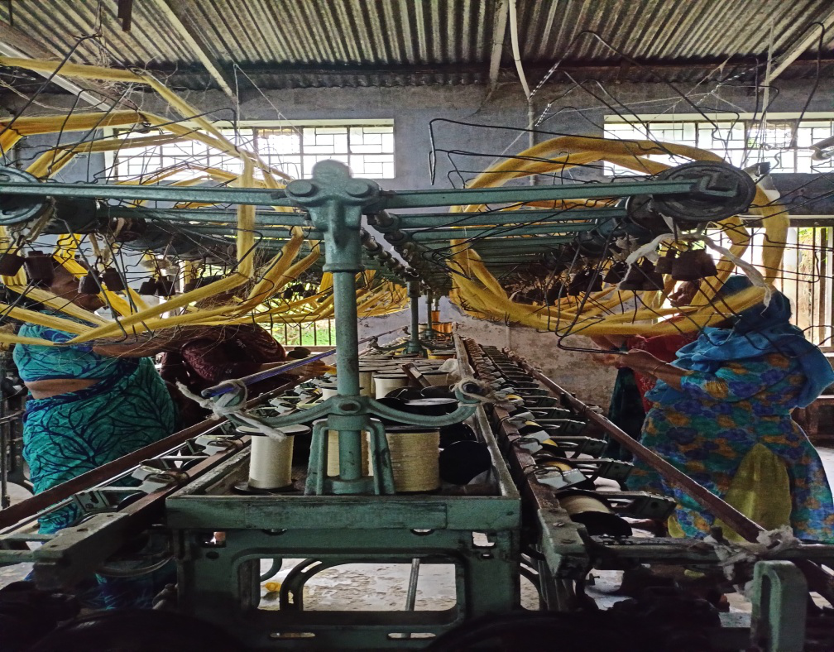
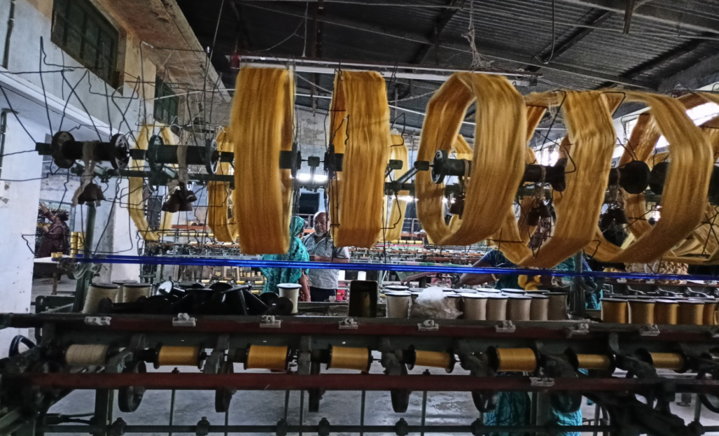
IoT Solution for Silk Production
Fig: Silk Reeling

Slide 10
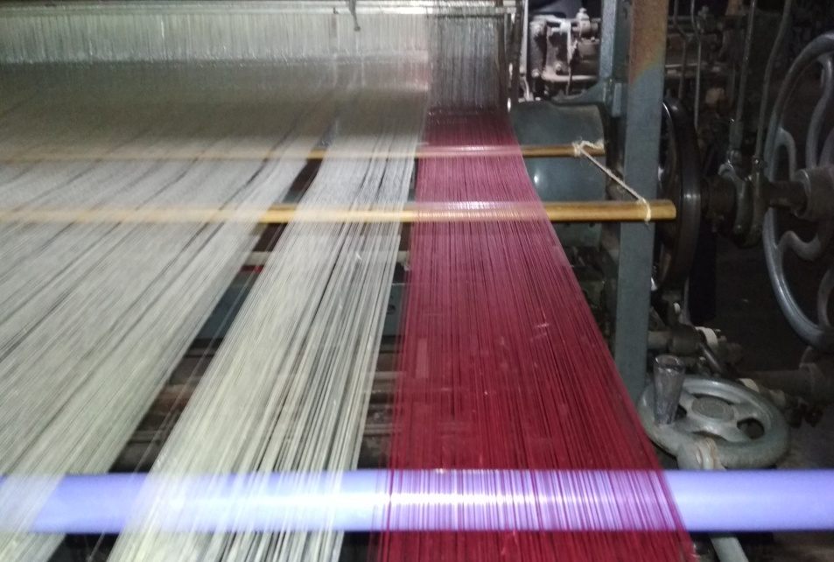
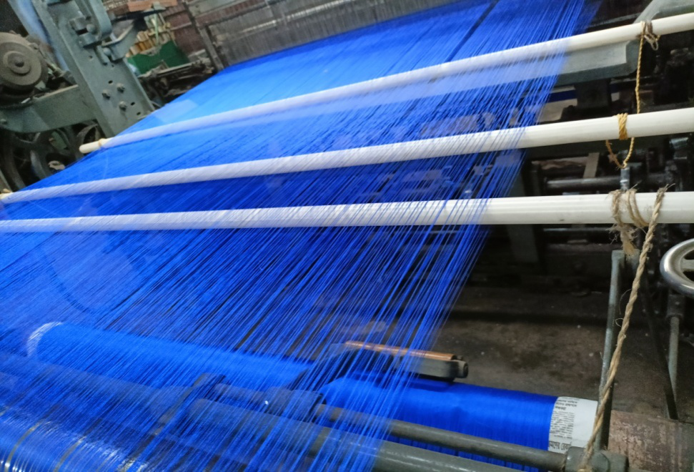
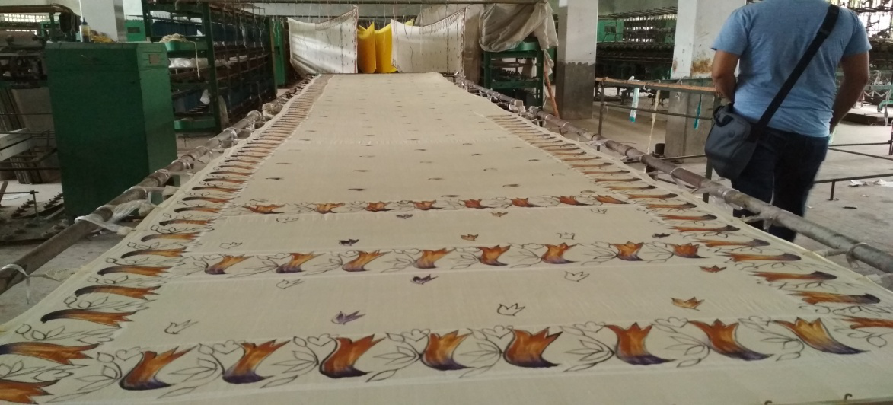
IoT Solution for Silk Production
Fig: Process of Sharee creation

Slide 11
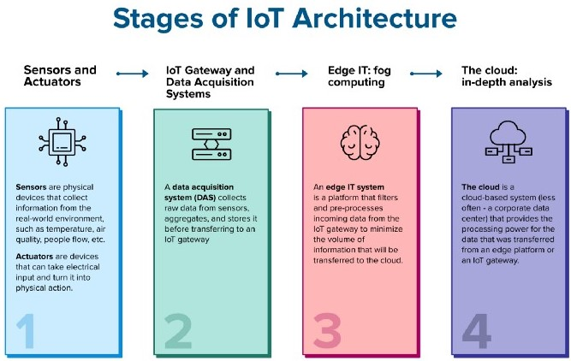
IoT Solution for Silk Production
What is Internet of Things(Iot)?
The Internet of things describes physical objects with sensors, processing ability, software, and other technologies that connect and exchange data with other devices and systems over the Internet or other communications networks.

Slide 12
IoT Solution for Silk Production
Why we need IoT in Sericulture?
Better monitoring system.
Better data collecting method.
Best suitable environment creation.
Low cost, high output.
Quality assurance.

Slide 13
IoT Solution for Silk Production
Stages of IoT implementation process
Installation stage
Testing and Observation stage
Analysis stage
Adjustment stage
Commercial stage

Slide 14
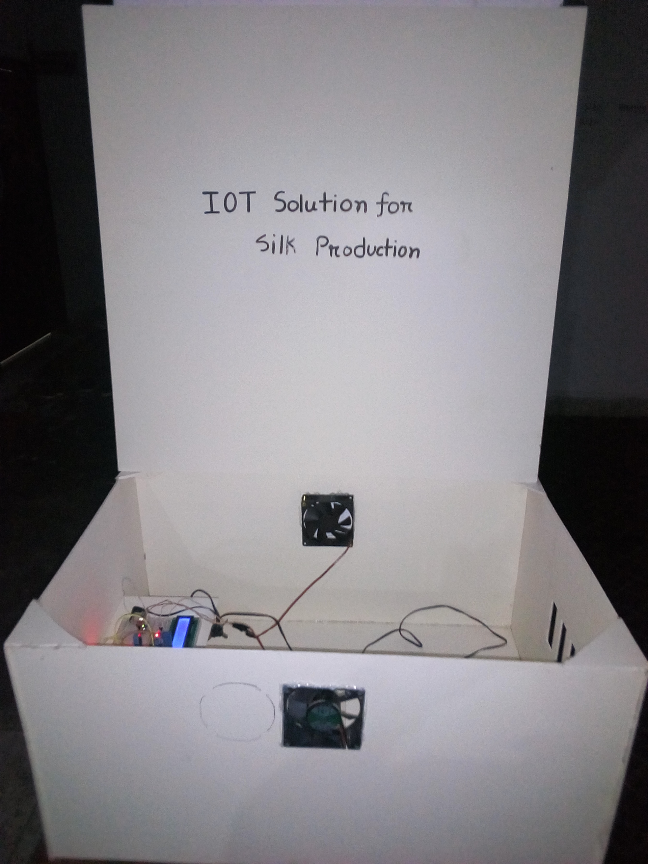
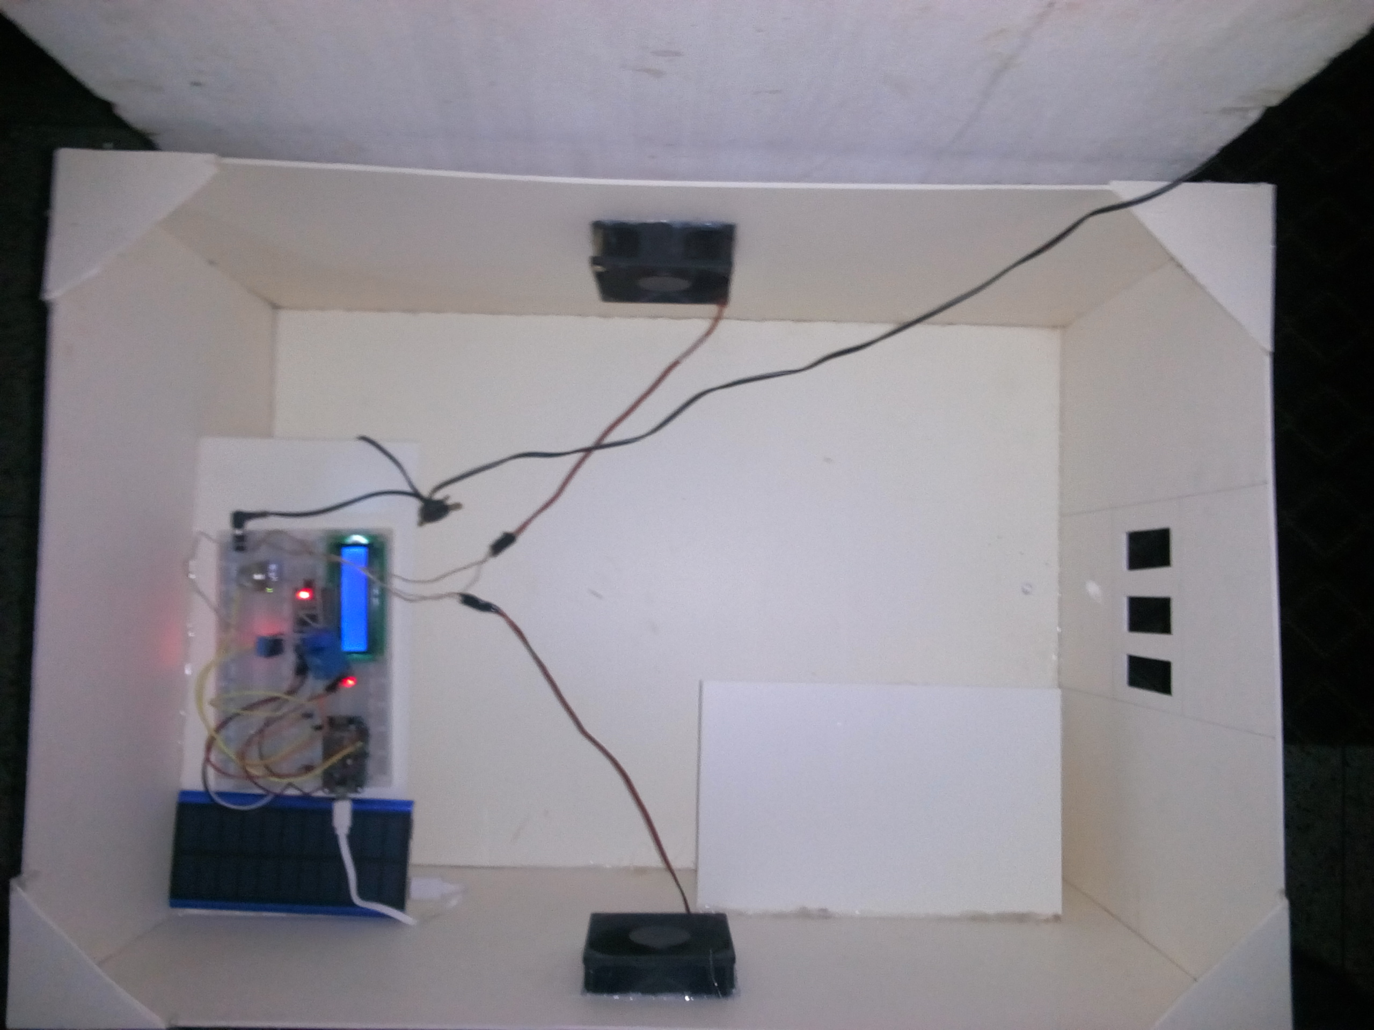
IoT Solution for Silk Production
Fig: An artificial environment for silkworm rearing using IoT

Slide 15
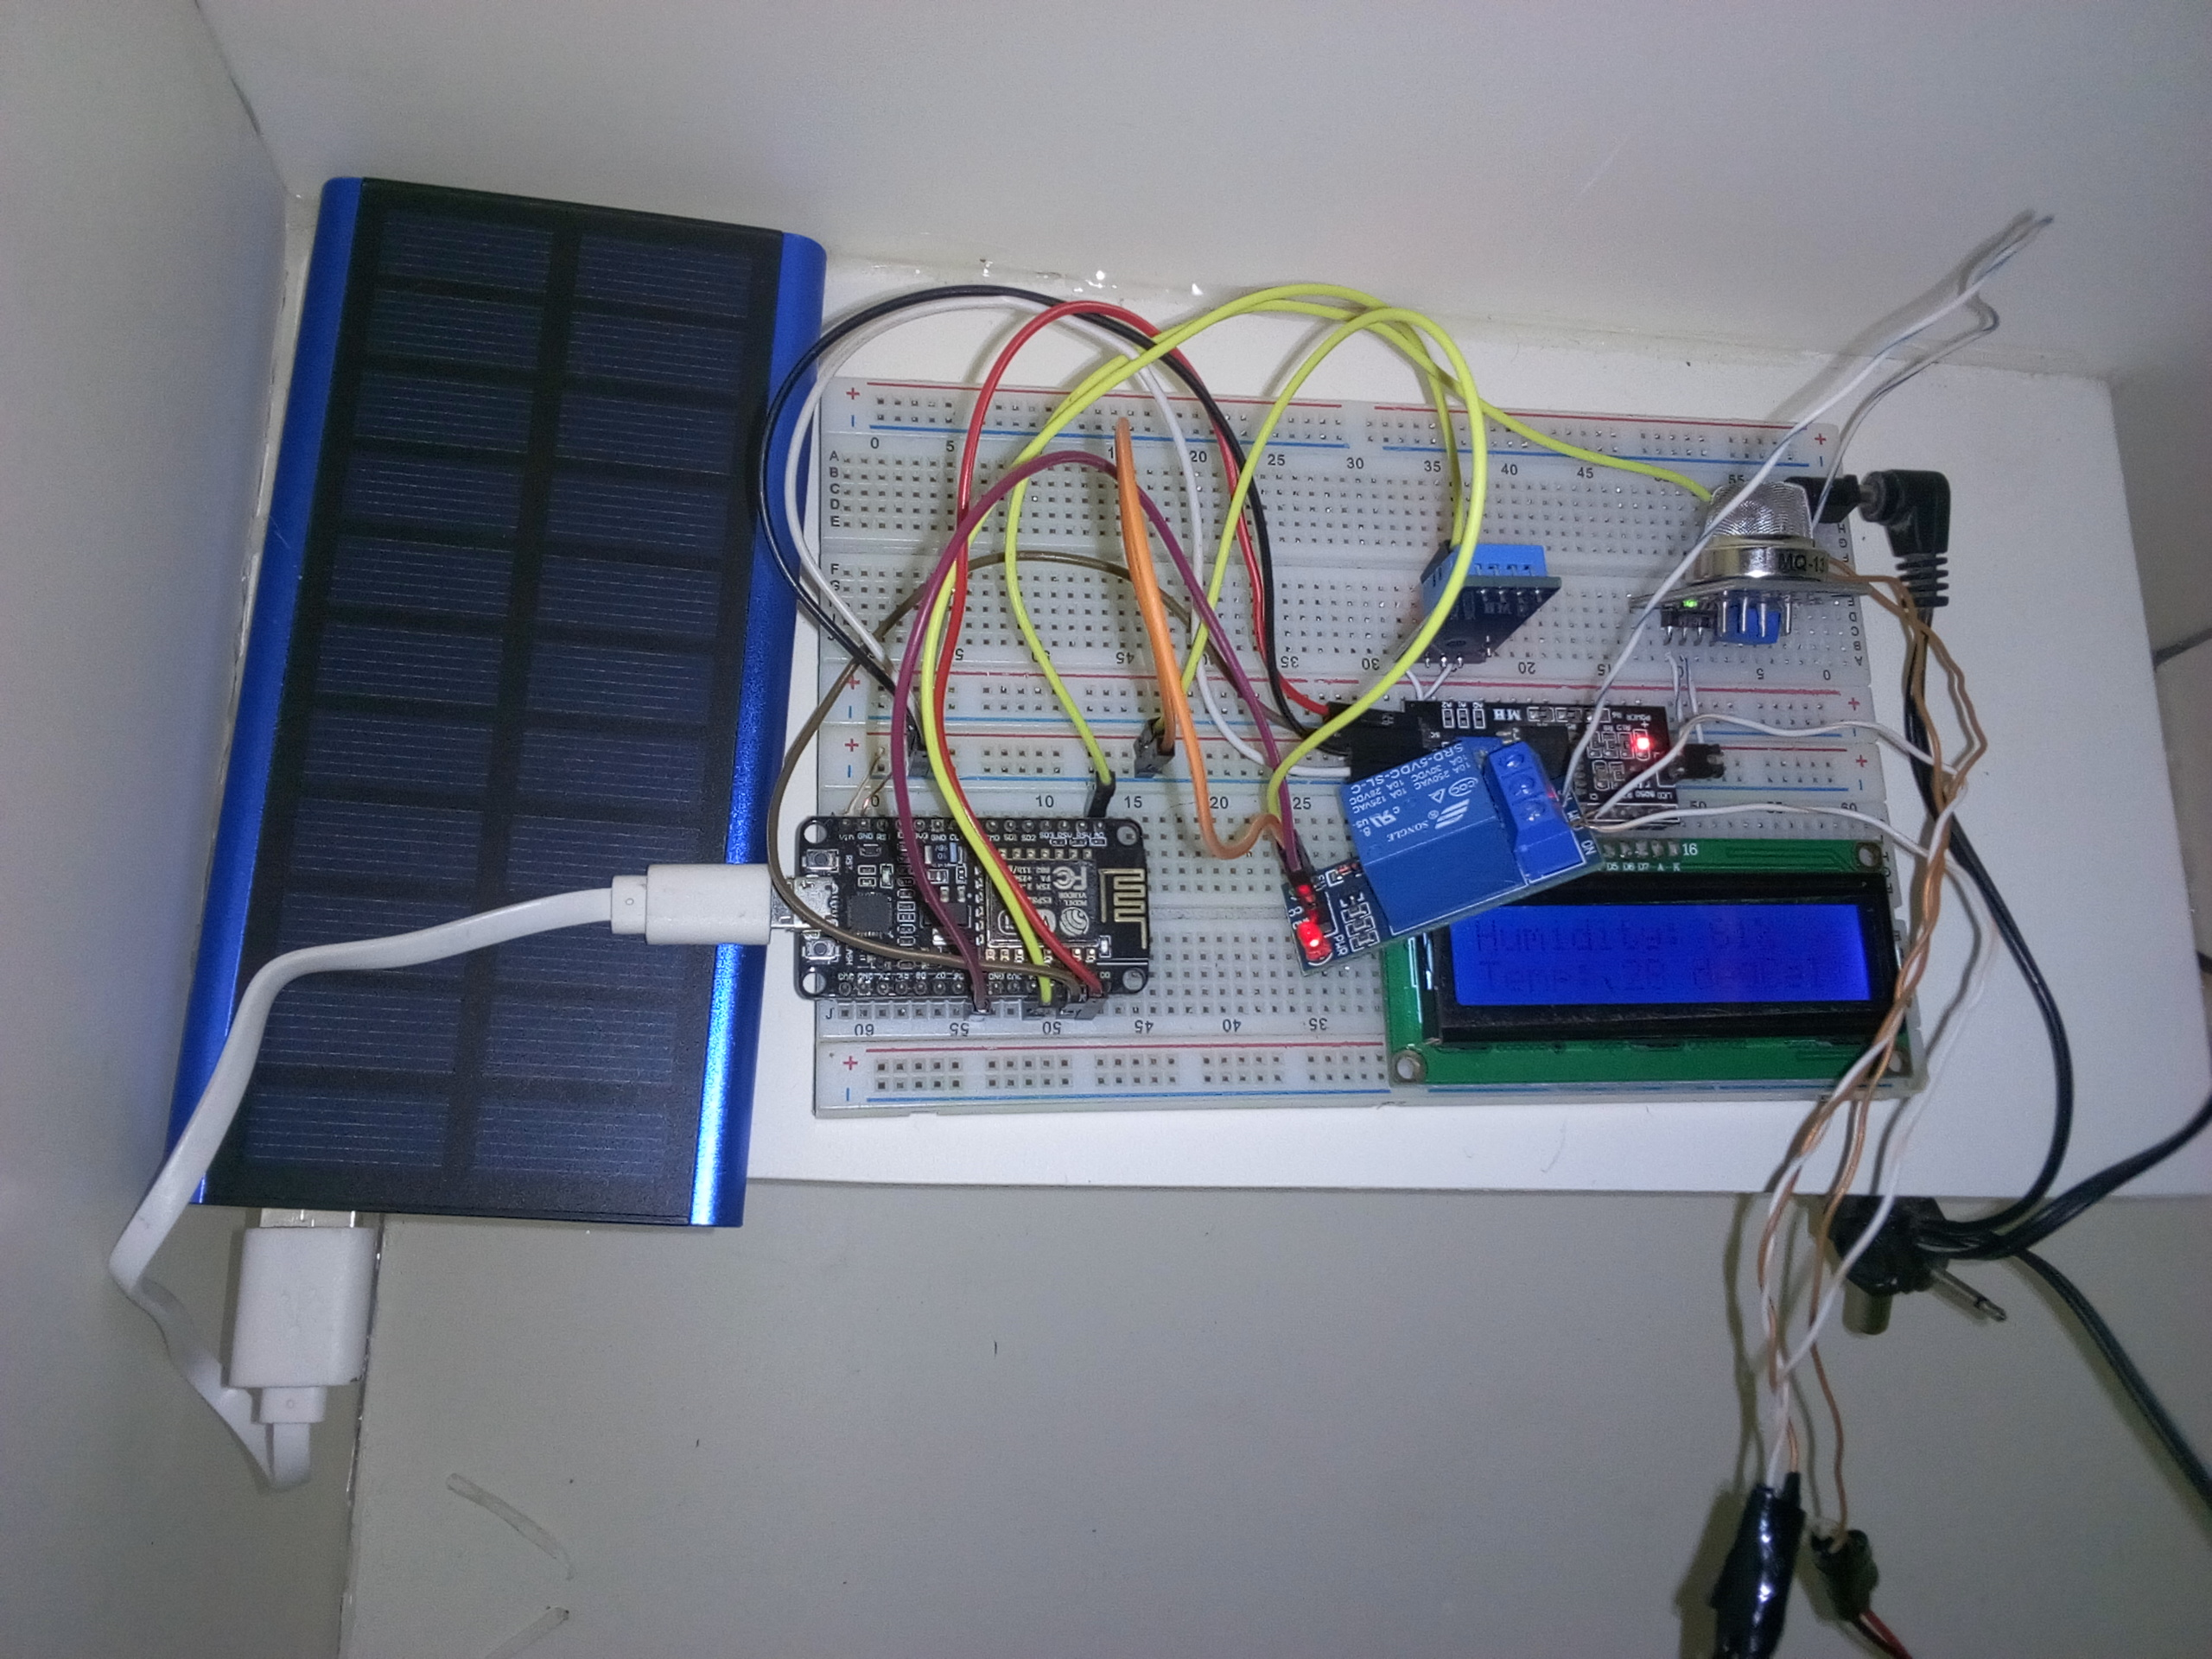
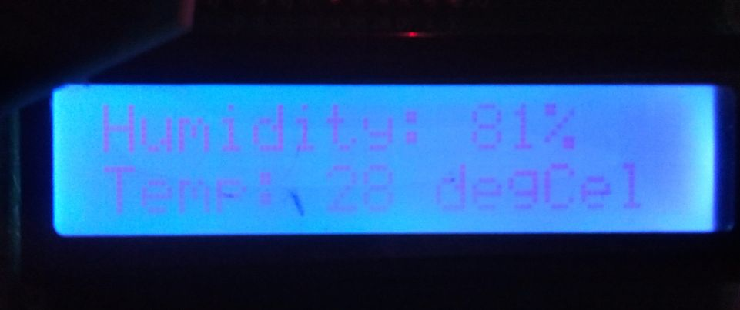
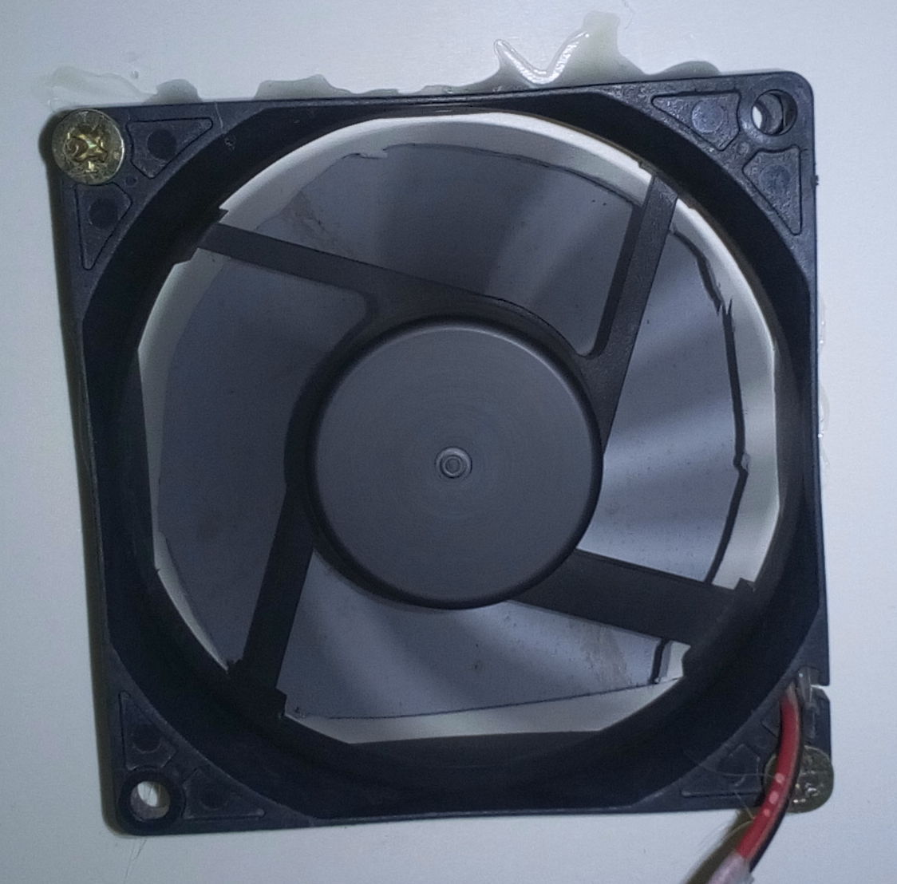
IoT Solution for Silk Production
Air Quality Sensor- MQ 135
Temperature Humidity Sensor-DHT11
Bread Board x2
I2C Module
16*2 LCD Display
PVC Board platform
Power Adapter
12V CPU Fan x2
Microcontroller-NodeMCU 12E
5V Relay Module
5V Solar Power Bank
Connecting Wires
Fig: The installed IoT system

Slide 16
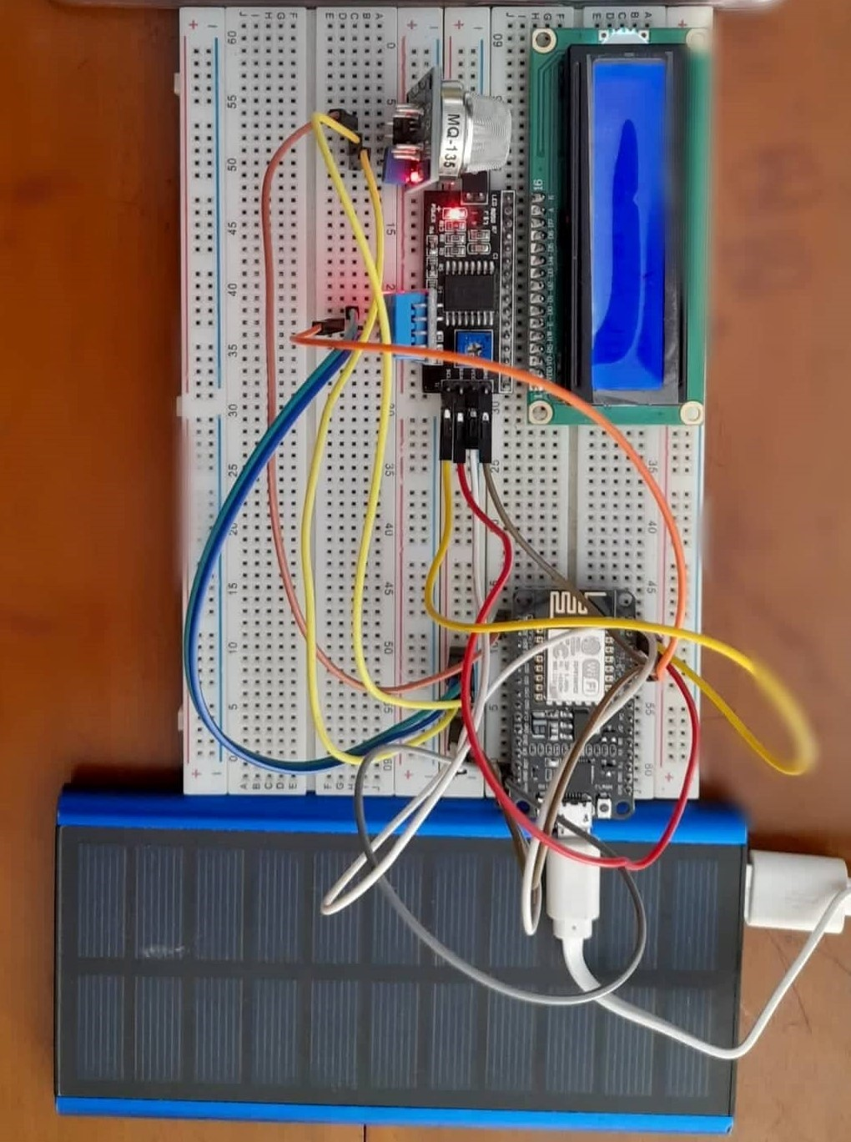
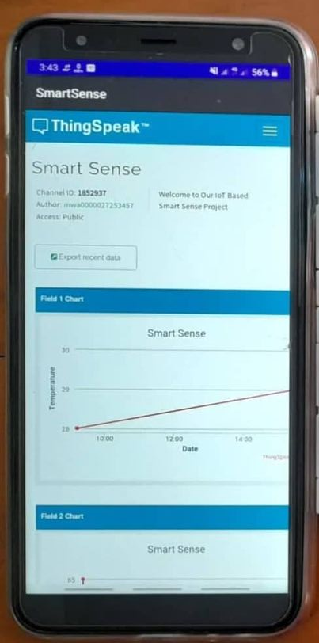
IoT Solution for Silk Production
Data Collection using Things Peak web Redirecting App
Temperature
Humidity
Air quality
Mechanism of air circulation
If temp > optimal temp:
Start the fan;
If air quality != normal:
Start the fan;

Slide 17
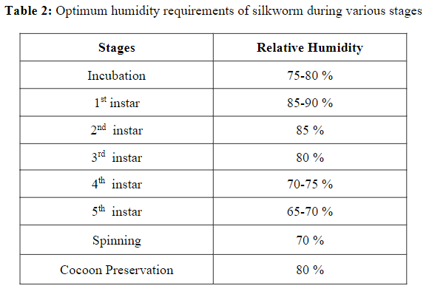
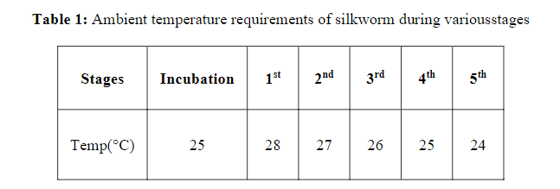
IoT Solution for Silk Production
Next Step
Testing the setup by co-operating with experienced farmers.
Observation and Collecting data
Possible improvement
Fig: Suitable temp and relative humidity for each stage in silkworm lifecycle

Slide 18
IoT Solution for Silk Production
Conclusions
It was a great joy and fun to work with each other to complete the installation stage. It is true that we still have to do lots to do. But, we are ready to take the challenge and continue till the end. It will be a huge achievement to play a role for modernizing and advancing of Bangladesh sericulture.

Slide 19
Acknowledgement
Prof. Dr. Md. Al Mamun, Professor, Head of CSE, RUET
For his supervising and support throughout the whole project.
Bangladesh Sericulture Development Board, Rajshahi
Rajshahi Sericulture Factory
For their warm hospitality and demonstration on sericulture and silk production.

Slide 20
References
Source: https://en.wikipedia.org/wiki/Sericulture
Jegadeesan S, Kavin P, Mohan Raj T, Vignesh R, "ISISF: IoT Based Smart Incubator for Sericulture Farm", International Journal of Modern Agriculture, Volume 10, No.2, 2021
Srinivas B, Khushi Kumari, Goverdhan Reddy H, Niranjan N, Hariprasad S A, Sunil M P, "IoT Based Automated Sericulture System", International Journal of Recent Technology and Engineering (IJRTE), ISSN: 2277-3878, Volume-8 Issue-2, July 2019
Nivaashini M., Soundariya R. S., Dinesh Kumar A., "Silkworm Growth Monitoring Smart Sericulture System based on Internet of Things (IOT) and Image Processing", International Journal of Computer Applications (0975 – 8887) Volume 180 – No.18, February 2018

